Slide 1

Evolutionary Optimization using Genetic Algorithms.
A Presentation By
Soumadip Dey
Assistant Professor, Dept. of Computational Sciences
For Course Code MCA17405(T) of 2025-2026 ODD Semester

Slide 2
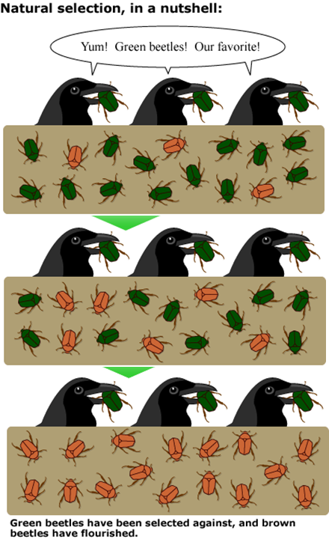
Genetic Algorithm
This algorithm design approach is a heuristic search approach that is formed by getting inspiration from Charles Darwin’s natural evolution theory.
It iteratively applies bio-inspired operators like selection, crossover, and mutation to evolve better solutions over generations, simulating "survival of the fittest" to "explore" the solution space.

Slide 3
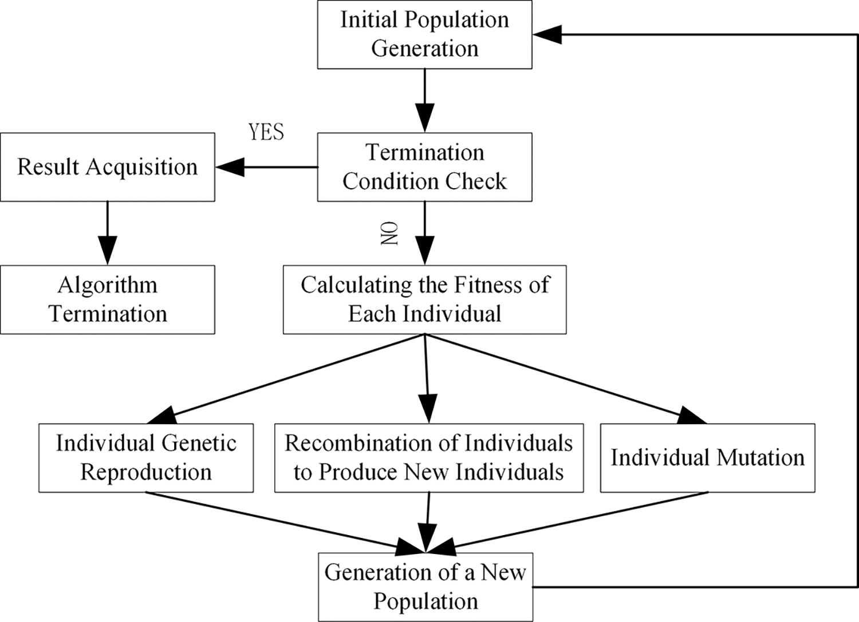
Steps Involved
A genetic algorithm has five main basic principles, as mentioned below.
Initialization: Set of entire population sample points marks as initialization of genetic algorithm.
Selection: Subset of the previous step to categorize data.
Crossover/recombination: For creating logical relations between sets and for reducing the degree of randomness among various sets.
Mutation: To generate genetic diversity.
Acceptance: For generating new offspring after mutation. Elimination also takes place in this stage.

Slide 4
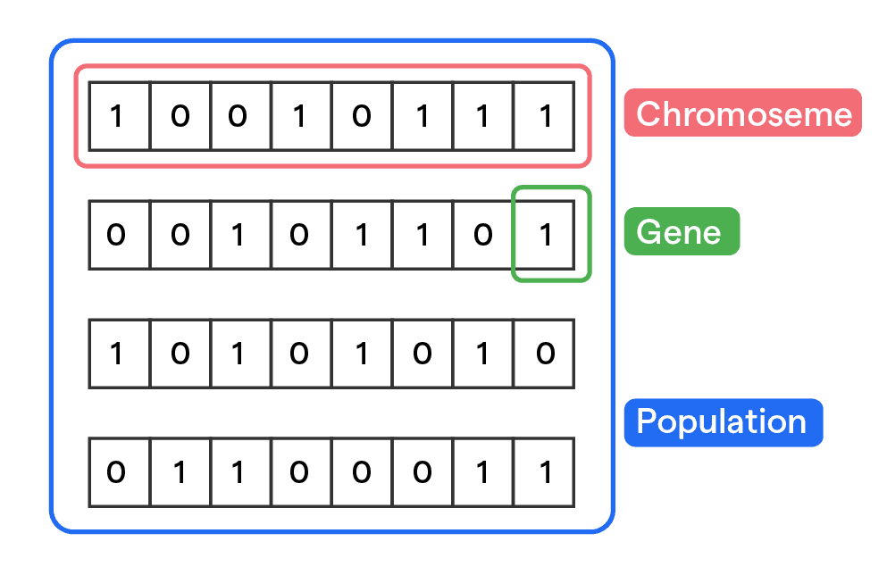
Core Concepts used in Genetic Algorithms

Slide 5
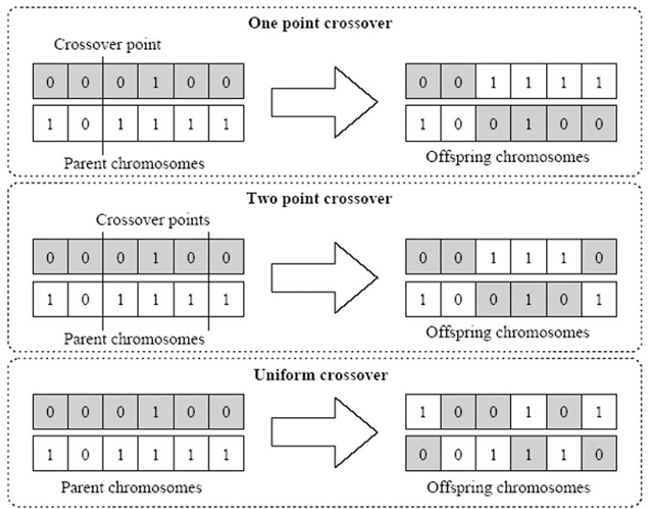
Crossover Operation
It is a reproduction operator that combines genetic material from two parent chromosomes to produce offspring, mimicking the nature of sexual reproduction to foster diversity and inherit beneficial traits.
Common Crossover Techniques:
One-point Crossover: Swap genes at a single point.
Two-point Crossover: Swap genes between two points.
Uniform Crossover: Mix genes randomly across the chromosome.

Slide 6
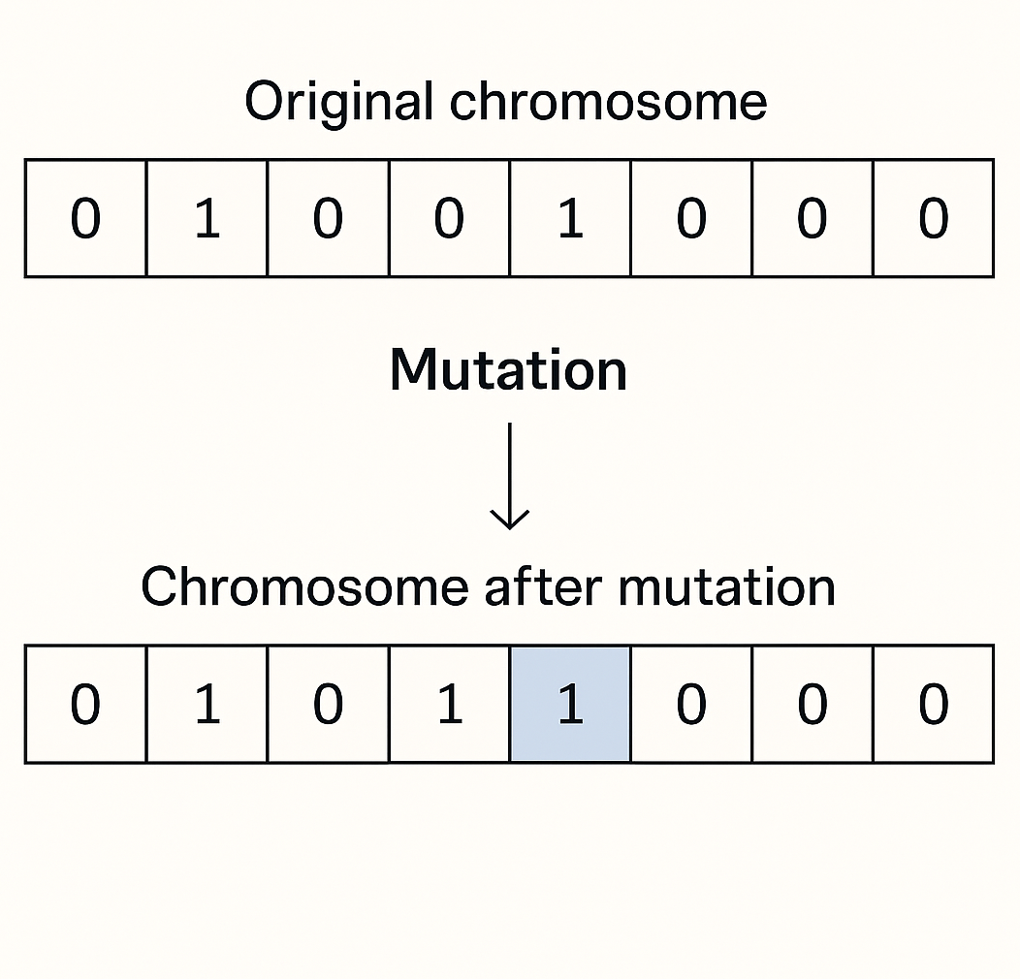
Mutation Operation
Mutation introduces random changes in chromosomes to maintain genetic diversity and help the algorithm escape local optima. Type of mutation depends on the encoding.
Binary Encoding: String of 0s and 1s
Bit-flip Mutation - Randomly flips one or more bits (0 ↔ 1)
Permutation Encoding: Used in ordering problems (e.g., TSP)
Swap Mutation: Exchange two genes
Inversion Mutation: Reverse a subset
Scramble Mutation: Shuffle a subset
Real-Valued Encoding: Used for continuous optimization.
Uniform Mutation: Replace gene with random value.
Creep (Gaussian) Mutation: Add small random change

Slide 7
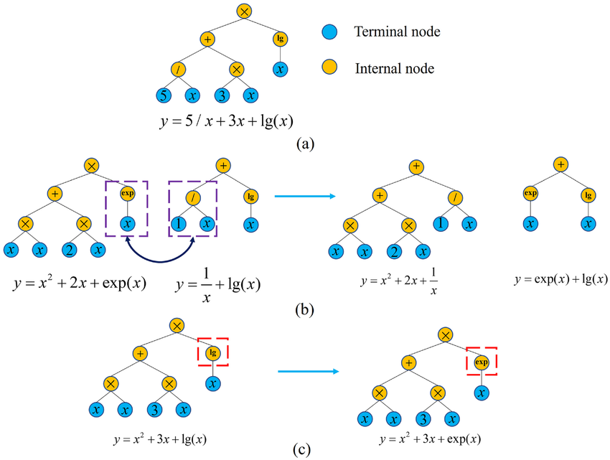
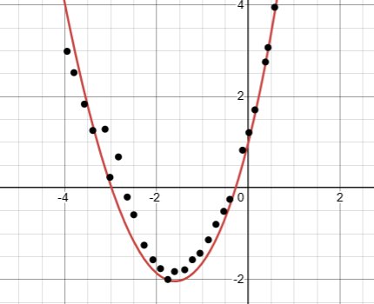
Application
These operations help us achieve
better equations in symbolic
regression problems that help
fit real world data points more
accurately.
Symbolic Regression binary tree, crossover, and variation:
(a) symbolic regression binary tree,
(b) crossover, and (c) mutation.

Slide 8
Thank You

